Slide 1
Cornerstone City Church Peninsula Plus Community Hoo Are Ya 22-01-2023

Slide 2
Glorious Day
CCLI Song # 7081388
Jason Ingram | Jonathan Smith | Kristian Stanfill | Sean Curran
© 2017 KPS 1.0 (Admin. by Capitol CMG Publishing)
sixsteps Music (Admin. by Capitol CMG Publishing)
sixsteps Songs (Admin. by Capitol CMG Publishing)
Sounds Of Jericho (Admin. by Capitol CMG Publishing)
Worship Together Music (Admin. by Capitol CMG Publishing)
worshiptogether.com songs (Admin. by Capitol CMG Publishing)
Fellow Ships Music (Admin. by Essential Music Publishing LLC)
Hickory Bill Doc (Admin. by Essential Music Publishing LLC)
So Essential Tunes (Admin. by Essential Music Publishing LLC)
For use solely with the SongSelect® Terms of Use. All rights reserved. www.ccli.com
CCLI Licence No. 33265

Slide 3
1/6
I was buried beneath my shame
Who could carry that kind of weight
It was my tomb 'til I met You

Slide 4
2/6
I was breathing but not alive
All my failures I tried to hide
It was my tomb 'til I met You

Slide 5
3/6
('Cause when) You called my name (and)
I ran out of that grave
Out of the darkness into Your glorious day
You called my name (and) I ran out of that grave
Out of the darkness into Your glorious day

Slide 6
4/6
Now Your mercy has saved my soul
Now Your freedom is all that I know
The old made new Jesus when I met You

Slide 7
5/6
I needed rescue my sin was heavy
But chains break at the weight of Your glory
I needed shelter I was an orphan
Now You call me a citizen of Heaven
When I was broken You were my healing
Now Your love is the air that I'm breathing
I have a future my eyes are open

Slide 8
6/6
('Cause when) You called my name (and)
I ran out of that grave
Out of the darkness into Your glorious day
You called my name (and)
I ran out of that grave
Out of the darkness into Your glorious day

Slide 9


Slide 10
Amazing Love
CCLI Song # 2456623
Billy J. Foote
© 1996 worshiptogether.com songs (Admin. by Capitol CMG Publishing)
For use solely with the SongSelect® Terms of Use. All rights reserved. www.ccli.com
CCLI Licence No. 33265

Slide 11
1/3
I'm forgiven
Because You were forsaken
I'm accepted
You were condemned
I'm alive and well
Your Spirit is within me
Because You died
And rose again

Slide 12
2/3
Amazing love
How can it be
That You my King
Would die for me
Amazing love
I know it's true
It's my joy to honor You
In all I do I honor You

Slide 13
3/3
You are my King
You are my King
Jesus You are my King
Jesus You are my King

Slide 15
I Give You My Heart
CCLI Song # 1866132
Reuben Morgan
© 1995 Hillsong Music Publishing Australia (Admin. by Hillsong Music Publishing UK)
For use solely with the SongSelect® Terms of Use. All rights reserved. www.ccli.com
CCLI Licence No. 33265

Slide 16
1/2
This is my desire
To honour You
Lord with all my heart
I worship You
All I have within me
I give You praise
All that I adore is in You

Slide 17
2/2
Lord I give You my heart
I give You my soul
I live for You alone
Ev'ry breath that I take
Ev'ry moment I'm awake
Lord have Your way in me

Slide 18
In Christ Alone
CCLI Song # 3350395
Keith Getty | Stuart Townend
© 2001 Thankyou Music (Admin. by Integrity Music Ltd)
For use solely with the SongSelect® Terms of Use. All rights reserved. www.ccli.com
CCLI Licence No. 33265

Slide 19
1/4
In Christ alone my hope is found
He is my light my strength my song
This Cornerstone this solid Ground
Firm through the fiercest drought and storm
What heights of love what depths of peace
When fears are stilled when strivings cease
My Comforter my All in All
Here in the love of Christ I stand

Slide 20
2/4
In Christ alone who took on flesh
Fullness of God in helpless babe
This gift of love and righteousness
Scorned by the ones He came to save
Till on that cross as Jesus died
The wrath of God was satisfied
For every sin on Him was laid
Here in the death of Christ I live

Slide 21
3/4
There in the ground His body lay
Light of the world by darkness slain
Then bursting forth in glorious Day
Up from the grave He rose again
And as He stands in victory
Sin's curse has lost its grip on me
For I am His and He is mine
Bought with the precious blood of Christ

Slide 22
4/4
No guilt in life no fear in death
This is the power of Christ in me
From life's first cry to final breath
Jesus commands my destiny
No power of hell no scheme of man
Can ever pluck me from His hand
Till He returns or calls me home
Here in the power of Christ I'll stand

Slide 24


Slide 25
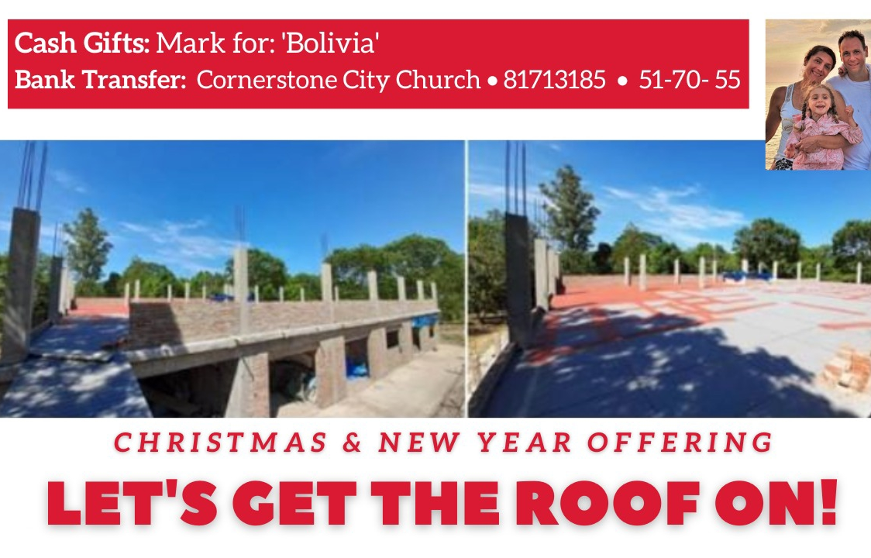

Slide 26


Slide 27


Slide 28
🇳 🇪 🇼 🇩 🇦 🇾 2⃣0⃣2⃣3⃣
Parents/Carers of 11-18 yr olds (year groups 6 - year groups 13)...
BOOKINGS ARE NOW OPEN!!
All the relevant info- including links to each of the 3 booking steps are in
the letter linked below:👇🏼👇🏼👇🏼👇🏼👇🏼👇🏼👇🏼👇🏼
Bit.ly/newday2023invitePlease note, the early bird cut off is 31st Jan.
Do get in touch if you have any questions or need to talk about finances!
202 days and counting...⏳⛺🎪⛺🎪⛺🎪⛺🎪⛺🎪Ps.
Here's a brief 60 second Newday promo for anyone who needs it...

Slide 29
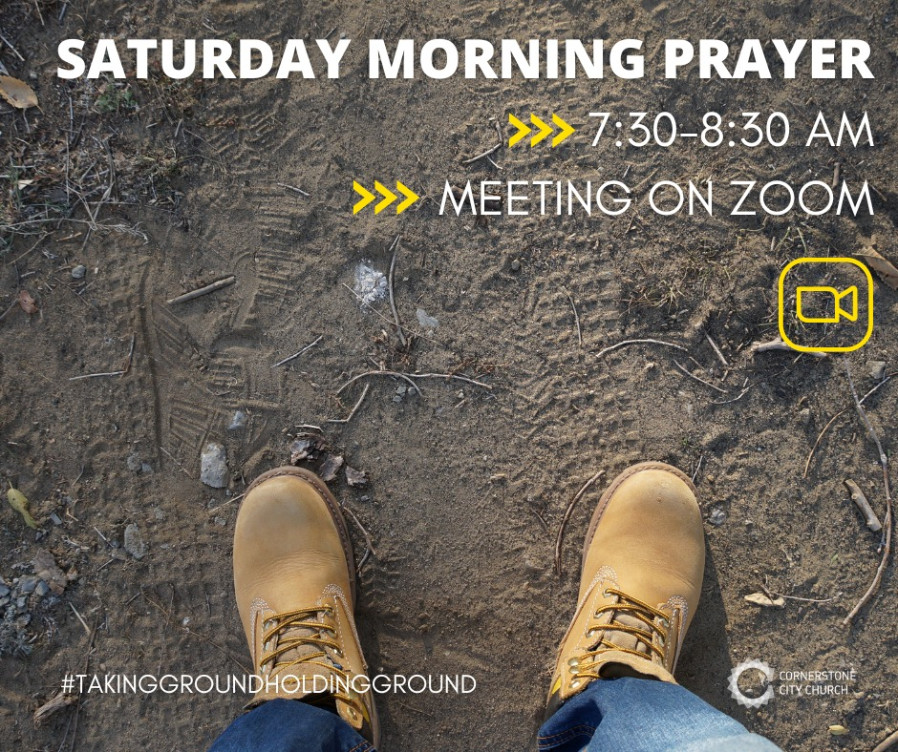

Slide 31
I Speak Jesus
CCLI Song # 7136201
Abby Benton | Carlene Prince | Dustin Smith | Jesse Reeves | Kristen Dutton | Raina Pratt
© 2019 Here Be Lions Publishing (Admin. by Integrity Music Ltd)
Integrity's Praise! Music (Admin. by Integrity Music Ltd)
BEC Worship (Admin. by Song Solutions)
Raina Pratt publishing designee (Admin. by Song Solutions www.songsolutions.org)
WriterWrong Music (Admin. by Song Solutions www.songsolutions.org)
Remaining portion is unaffiliated
For use solely with the SongSelect® Terms of Use. All rights reserved. www.ccli.com
CCLI Licence No. 33265

Slide 32
1/5
I just want to speak the Name of Jesus
Over ev'ry heart and ev'ry mind
'Cause I know there is peace within Your presence
I speak Jesus

Slide 33
2/5
I just want to speak the Name of Jesus
'Til ev'ry dark addiction starts to break
Declaring there is hope and there is freedom
I speak Jesus

Slide 34
3/5
('Cause) Your Name is power
Your Name is healing
Your Name is life
Break ev'ry stronghold
Shine through the shadows
Burn like a fire

Slide 35
4/5
I just want to speak the Name of Jesus
Over fear and all anxiety
To ev'ry soul held captive by depression
I speak Jesus

Slide 36
5/5
Shout Jesus from the mountains
Jesus in the streets
Jesus in the darkness over ev'ry enemy
Jesus for my fam'ly
I speak the holy Name Jesus

